Slide 1
Data Structures in Python
Module 2

Slide 2
Outline
1. Data structures in Python
List
Tuple
Dictionary
Set
Arrays
2. Conversions of Data Structures

Slide 3
Data Structures
Data Structures are a way of organizing data so that it can be accessed more efficiently depending upon the situation.
Data Structures are fundamentals of any programming language around which a program is built.
Built in Data Structures in Python are:
List
Tuple
Dictionary
Set

Slide 4
List
The Python List is an ordered collection (also known as a sequence ) of elements. List elements can be accessed, iterated, and removed according to the order they inserted at the creation time.
We use the list data type to represent groups of the element as a single entity. For example: If we want to store all student’s names, we can use list type.
The list can contain data of all data types such as int, float, string
Duplicates elements are allowed in the list
The list is mutable which means we can modify the value of list elements
We can create a list using the two ways:
1. By enclosing elements in the square brackets [].
2. Using a list() class.

Slide 5
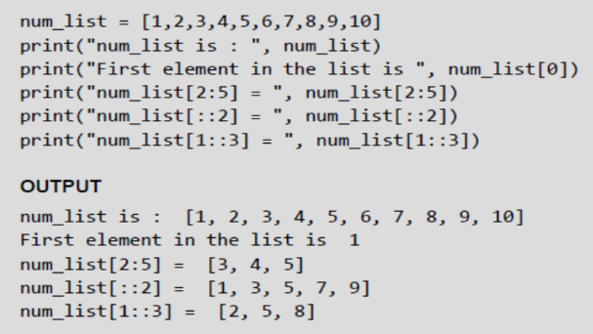
Access Values in Lists
Similar to strings, lists can also be sliced and concatenated.
To access values in lists, square brackets are used to slice along with the index or indices to get value stored at that index.
The syntax for the slice operation is given as, seq = List[start:stop:step]

Slide 6
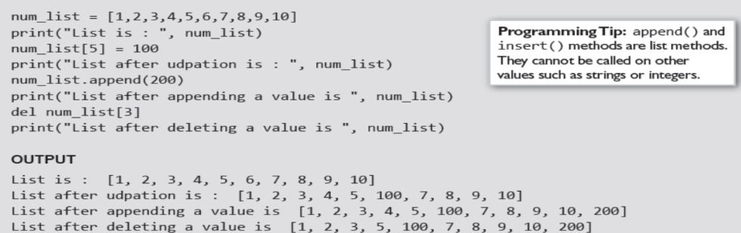
Updating Values in Lists
Once created, one or more elements of a list can be easily updated by giving the slice on the left-hand side of the assignment operator.
You can also append new values in the list and remove existing value(s) from the list using the append() method and del statement respectively.

Slide 7
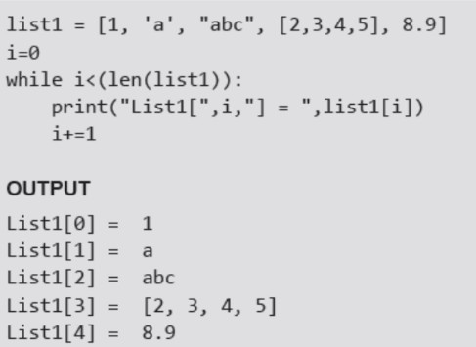
Nested Lists
Nested list means a list within another list.
A list has elements of different data types which can include even a list.

Slide 8
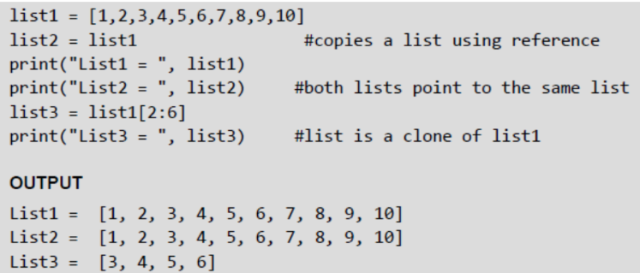
Cloning Lists
If you want to modify a list and also keep a copy of the original list, then you should create a separate copy of the list (not just the reference). This process is called cloning.
The slice operation is used to clone a list.

Slide 9
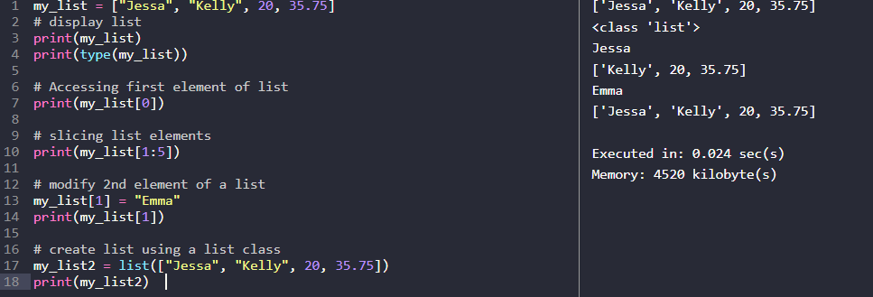
Example : List

Slide 10
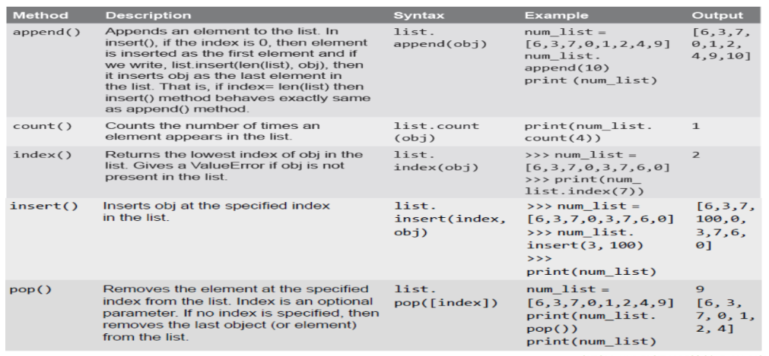
Basic List Operations

Slide 11
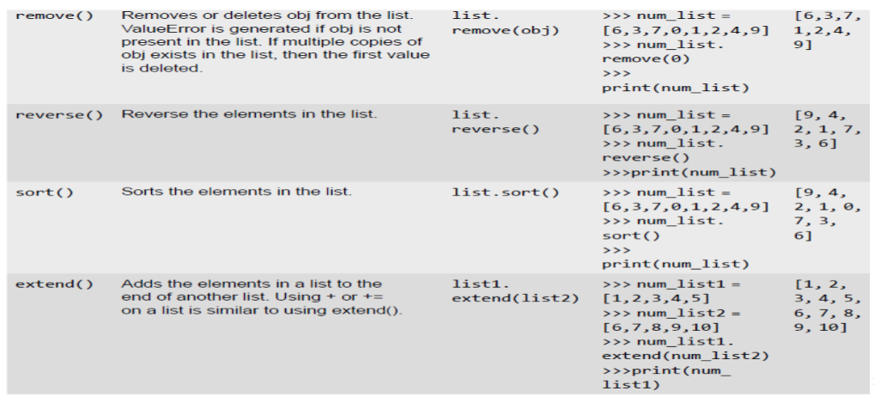
List Methods

Slide 12
Tuple
Tuples are ordered collections of elements that are unchangeable. The tuple is the same as the list, except the tuple is immutable means we can’t modify the tuple once created.
In other words, we can say a tuple is a read-only version of the list.
For example: If you want to store the roll numbers of students that you don’t change, you can use the tuple data type.
Note: Tuple maintains the insertion order and also, allows us to store duplicate elements.
We can create a tuple using the two ways:
1. By enclosing elements in the parenthesis ()
2. Using a tuple() class.

Slide 13
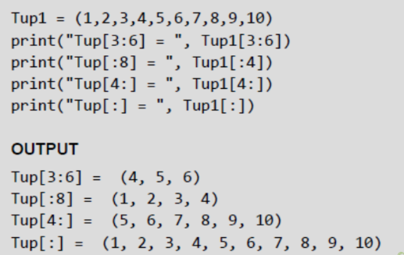
Accessing Values in a Tuple
Like other sequences (strings and lists) covered so far, indices in a tuple also starts at 0.
You can even perform operations like slice, concatenate, etc. on a tuple. For example, to access values in tuple, slice operation is used along with the index or indices to obtain value stored at that index

Slide 14
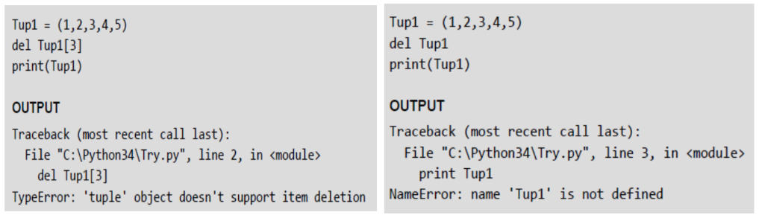
Deleting Elements in Tuple
Since tuple is an immutable data structure, you cannot delete value(s) from it.
Of course, you can create a new tuple that has all elements in your tuple except the ones you don't want (those you wanted to be deleted).

Slide 15
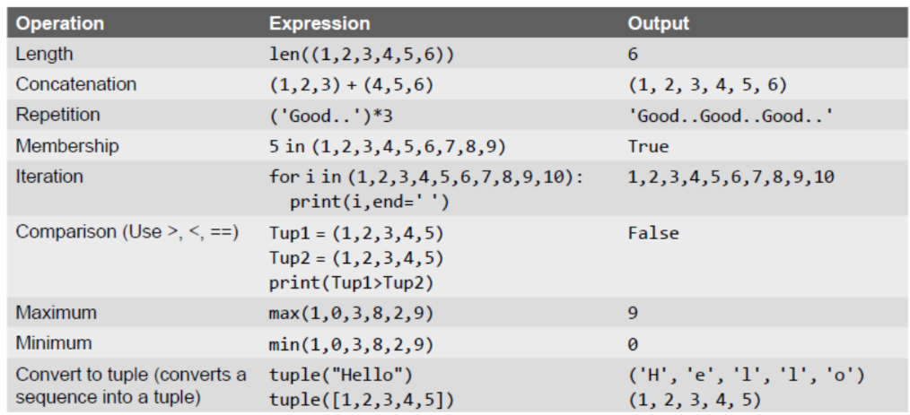
Basic Tuple Operations

Slide 16
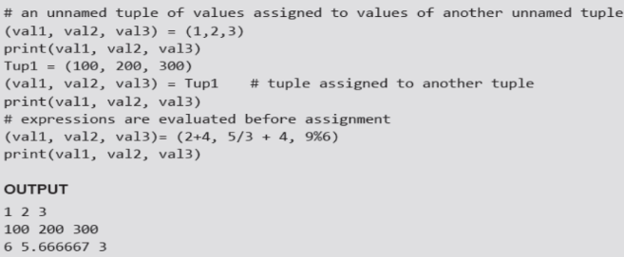
Tuple Assignment
Tuple assignment is a very powerful feature in Python.
It allows a tuple of variables on the left side of the assignment operator to be assigned values from a tuple given on the right side of the assignment operator.
Each value is assigned to its respective variable. In case, an expression is specified on the right side of the assignment operator, first that expression is evaluated and then assignment is done.

Slide 17
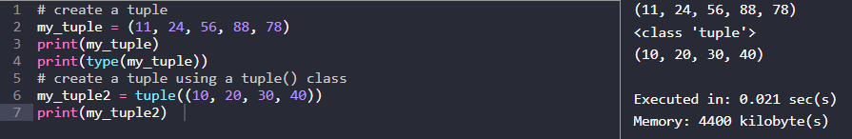
Example: Tuple

Slide 18
Dictionary
In Python, dictionaries are unordered collections of unique values stored in (Key-Value) pairs. Use a dictionary data type to store data as a key-value pair.
The dictionary type is represented using a dict class. For example, If you want to store the name and roll number of all students, then you can use the dict type.
In a dictionary, duplicate keys are not allowed, but the value can be duplicated. If we try to insert a value with a duplicate key, the old value will be replaced with the new value.
Dictionary has some characteristics which are listed below:
A heterogeneous (i.e., str, list, tuple) elements are allowed for both key and value in a dictionary. But An object can be a key in a dictionary if it is hashable.
The dictionary is mutable which means we can modify its items
Dictionary is unordered so we can’t perform indexing and slicing

Slide 19
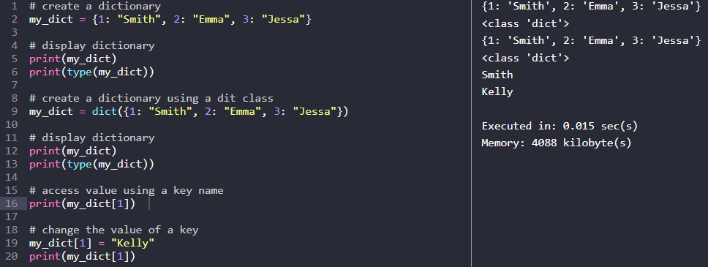
Example:
We can create a dictionary using the two ways
By enclosing key and values in the curly brackets {}
Using a dict() class.

Slide 20
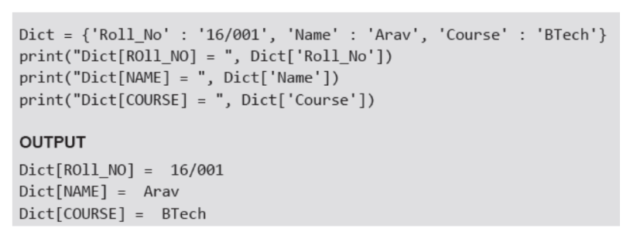
Accessing Values of Dictionary

Slide 21
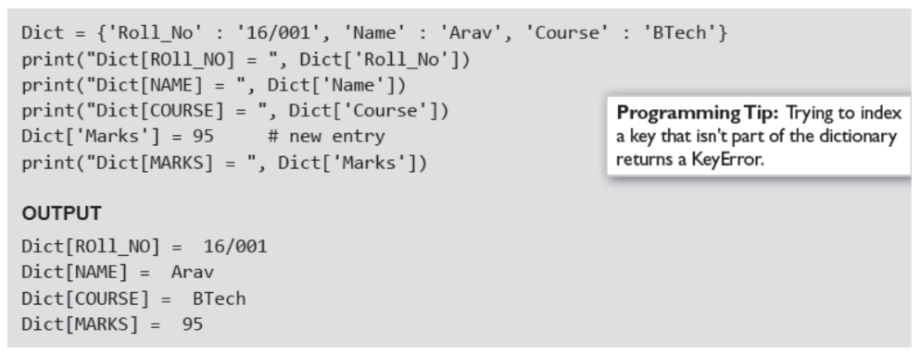
Adding and Modifying an Item in a Dictionary

Slide 22
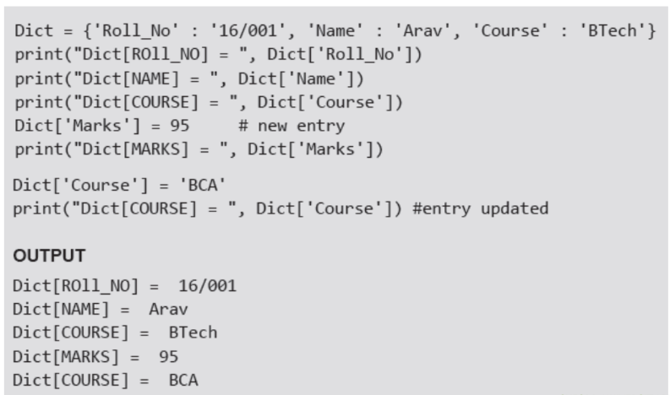
Modifying an Entry in Dictionary

Slide 23
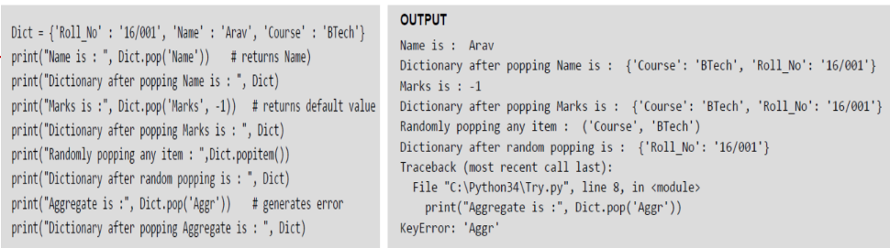
Deleting Items from Dictionary
You can delete one or more items using the del keyword. To delete or remove all the items in just one statement, use the clear() function.
Finally, to remove an entire dictionary from the memory, we can gain use the del statement as del Dict_name. The syntax to use the del statement can be given as,
del dictionary_variable[key]

Slide 24
Difference between a List and a Dictionary
First, a list is an ordered set of items. But, a dictionary is a data structure that is used for matching one item (key) with another (value).
Second, in lists, you can use indexing to access a particular item. But, these indexes should be a number. In dictionaries, you can use any type (immutable) of value as an index. For example, when we write Dict['Name'], Name acts as an index but it is not a number but a string.
Third, lists are used to look up a value whereas a dictionary is used to take one value and look up another value. For this reason, dictionary is also known as a lookup table.
Fourth, the key-value pair may not be displayed in the order in which it was specified while defining the dictionary. This is because Python uses complex algorithms (called hashing) to provide fast access to the items stored in the dictionary. This also makes dictionary preferable to use over a list of tuples.

Slide 25
Set
In Python, a set is an unordered collection of data items that are unique. In other words, Python Set is a collection of elements (Or objects) that contains no duplicate elements.
In Python, the Set data type used to represent a group of unique elements as a single entity. For example, If we want to store student ID numbers, we can use the set data type.
The Set data type in Python is represented using a set class.
We can create a Set using the two ways
By enclosing values in the curly brackets {}
Using a set() class.
The set data type has the following characteristics.
It is mutable which means we can change set items
Duplicate elements are not allowed
Heterogeneous (values of all data types) elements are allowed
Insertion order of elements is not preserved, so we can’t perform indexing on a Set

Slide 26
Some common useful set commands are as follow:
# define an empty set a_set = set()
# define a set a_set = {'one', 2}
# adding item to a set a_set.add('c')
# removing an item from a set, raise keyError if item does not exist a_set.remove('one')
# removing an item from a set, no keyError if item does not exist a_set.discard('one')
# remove the first item from a set and return it a_set.pop()
# remove all items from a set a_set.clear()

Slide 27
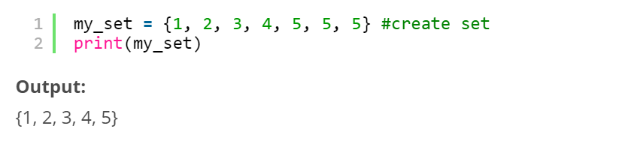
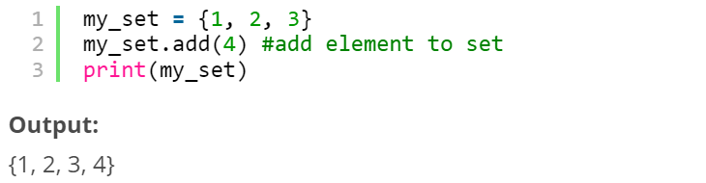
Example:
Creating a set
Sets are created using the flower braces but instead of adding key-value pairs, you just pass values to it.
Adding elements
To add elements, you use the add() function and pass the value to it.

Slide 28
Operations in sets
The different operations on set such as union, intersection and so on are shown below.
The union() function combines the data present in both sets.
The intersection() function finds the data present in both sets only.
The difference() function deletes the data present in both and outputs data present only in the set passed.
The symmetric_difference() does the same as the difference() function but outputs the data which is remaining in both sets.

Slide 29
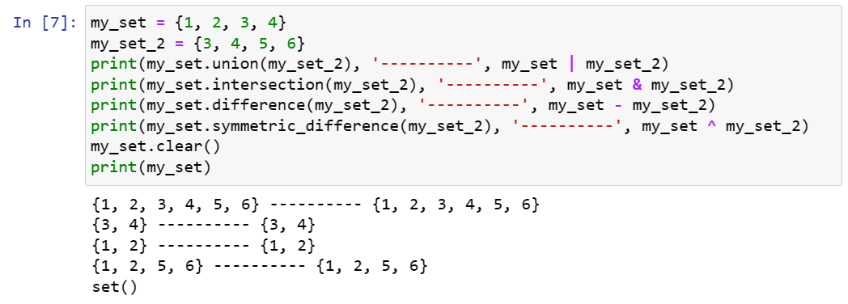
Example:

Slide 30
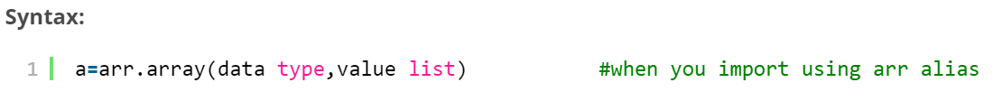
Arrays
Arrays and lists are the same structure with one difference, Lists allow heterogeneous data element storage whereas Array allow only homogenous elements to be stored within them.
Arrays in Python can be created after importing the array module as follows –
→ import array as arr
The array(data type, value list) function takes two parameters, the first being the data type of the value to be stored and the second is the value list.

Slide 31
Conversions of Data Structures

Slide 32
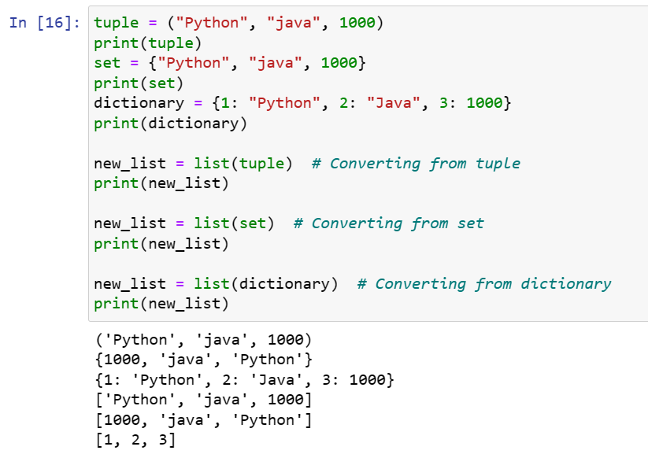
Converting to a List
a tuple, set, or dictionary can be converted to a list using the list() constructor.
In the case of a dictionary, only the keys will be converted to a list.

Slide 33
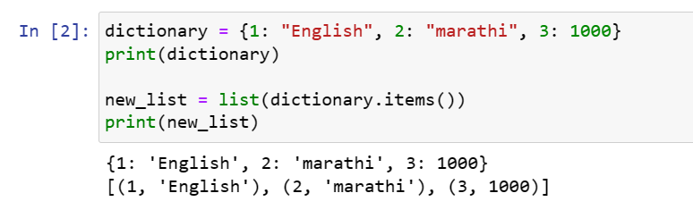
We can use the dict.items() method of a dictionary to convert it into an iterable of (key, value) tuples. This can further be cast into a list of tuples using list()

Slide 34
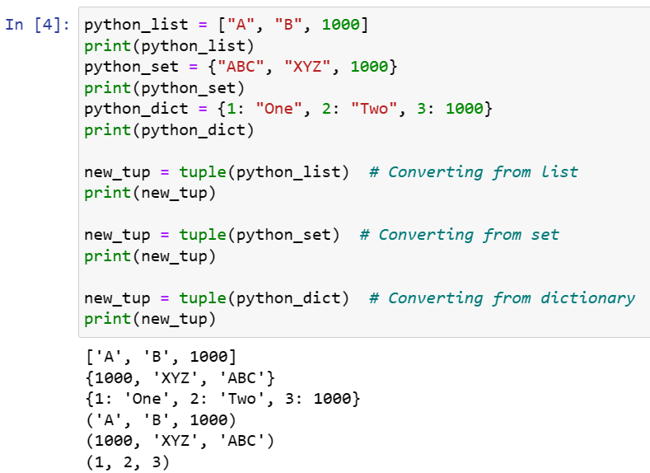
Converting to a Tuple
Any data structure can be converted to a tuple using the tuple() constructor. In the case of a dictionary, only the keys will be converted to a tuple

Slide 35
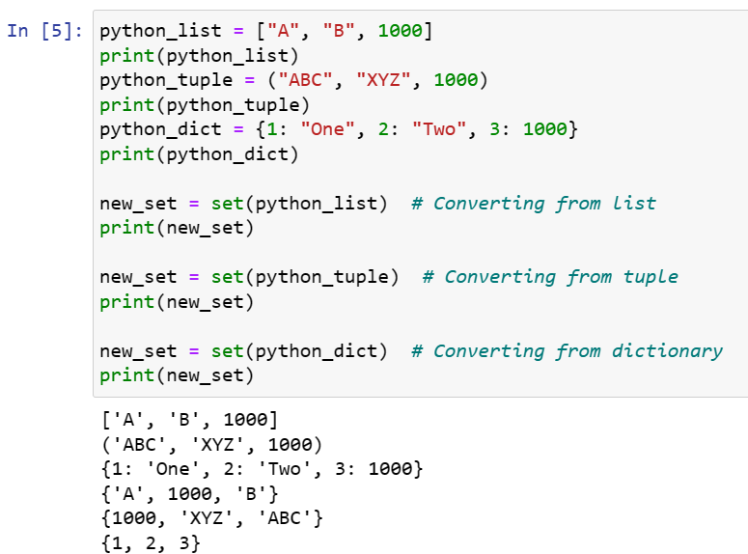
Converting to a Set
The set() constructor can be used to create a set out of any other data structure. In the case of a dictionary, only the keys will be converted to a set

Slide 36
Converting to a dictionary
The dict() constructor cannot be used in the same way as the others because it requires key-value pairs instead of just values. Hence, the data must be stored in a format where pairs exist.
For example, a list of tuples where the length of each tuple is 2 can be converted into a dictionary.
Those pairs will then be converted into key-value pairs

Slide 37
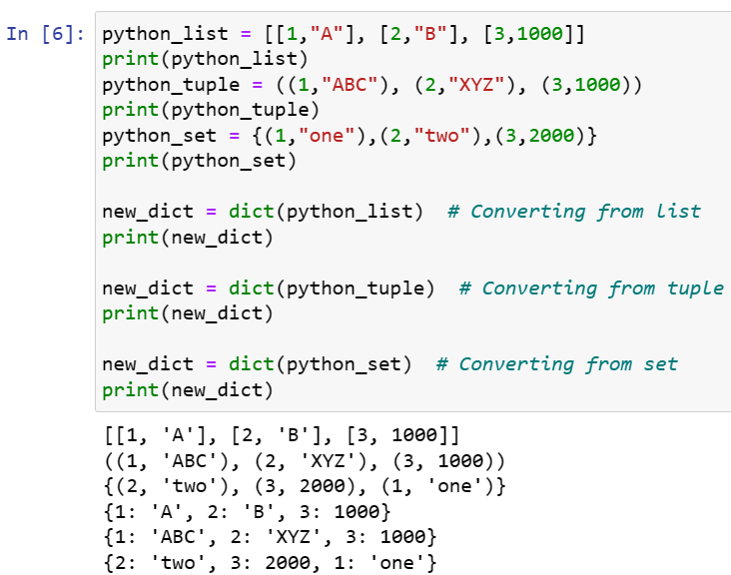
Example

Slide 38
When to use which Data Structure?
Use lists to store a collection of data that does not need random access.
Use lists if the data has to be modified frequently.
Use a set if you want to ensure that every element in the data structure must be unique.
Use tuples when you want that your data should not be altered.

